Slide 1



GOVERNMENT OF KARNATAKA
DEPARTMENT OF COLLEGIATE TECHNICAL EDUCATION
GOVERNMENT ENGINEERING COLLEGE TALAKAL,KOPPAL-583238
DEPARTMENT OF COMPUTER SCIENCE & ENGINEERING
PROJECT ON
“CONSTRUCTION DYNAMIC PROJECT”
Under the guidance of:
Presented by:
RAMYASHREE V 2LG21CS033
SAVITHRA LINGANAGOUDRU 2LG21CS037
VIJAY KUMAR T 2LG21CS050
IMAMSAB BEDAVATTI 2LG21CS056

Slide 2
CONTENTS
Abstract
Introduction
Methodology
Advantages & Disadvantages
Applications
Results
Future Scope
Conclusion

Slide 3
ABSTRACT
Dynamic web application developed for a construction company to showcase its projects, offered services, and customer testimonials in an interactive.
Projects are presented with detailed descriptions, images, and categories to help potential clients explore relevant work.
Services are dynamically listed to highlight the company’s capabilities, while a testimonials section displays client feedback to build trust and credibility.

Slide 4
INTRODUCTION
Project aims to develop a dynamic web application for a construction company allows for the real-time display content such as projects, services, and testimonials.
Displays completed and ongoing construction projects with images, descriptions, and categories.
Project highlights client experiences and reviews to enhance the company's reputation and customer trust.

Slide 5
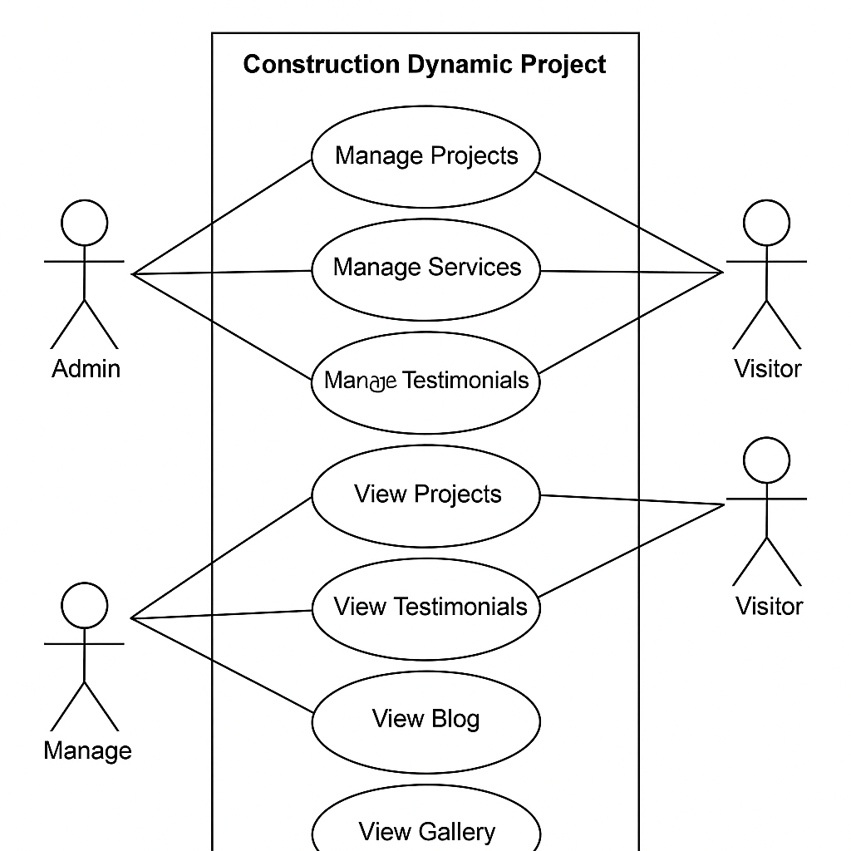
METHODOLOGY

Slide 6
ADVANTAGES
Rapid Development
Microservices Architecture
Cloud Integration
Security & Monitoring
Embedded Server Support

Slide 7
DISADVANTAGES
High Memory Consumption
Limited Control Over Dependencies
Complex Migration Process
Not Ideal for Large Monolithic Applications
Steep Learning Curve for Beginners

Slide 8
APPLICATIONS
Project Management Systems
IoT-Enabled Monitoring
Automated Workflow Systems
Predictive Analytics & AI Integration
Cloud-Based Collaboration Tools

Slide 9
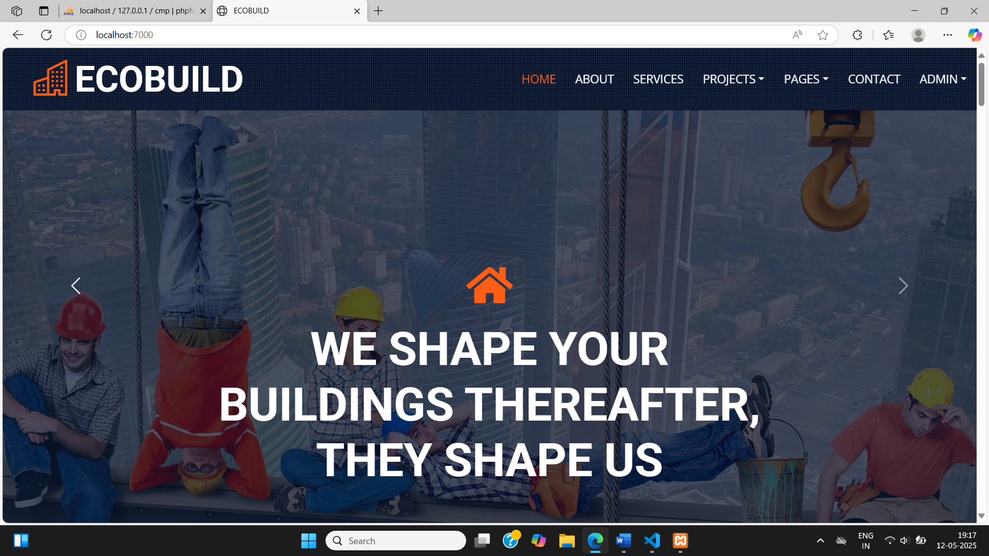
RESULTS
Fig 1:Home Page

Slide 10
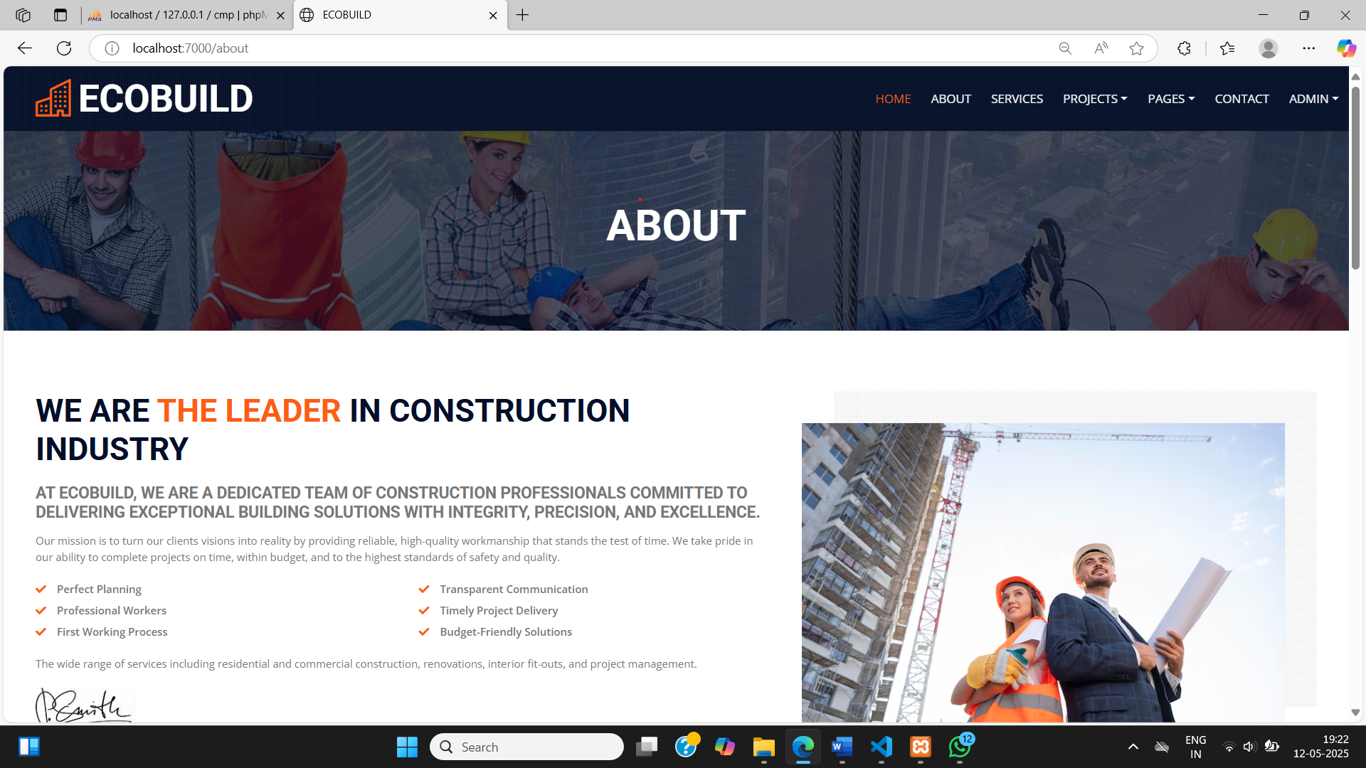
Fig 2:About Us

Slide 11
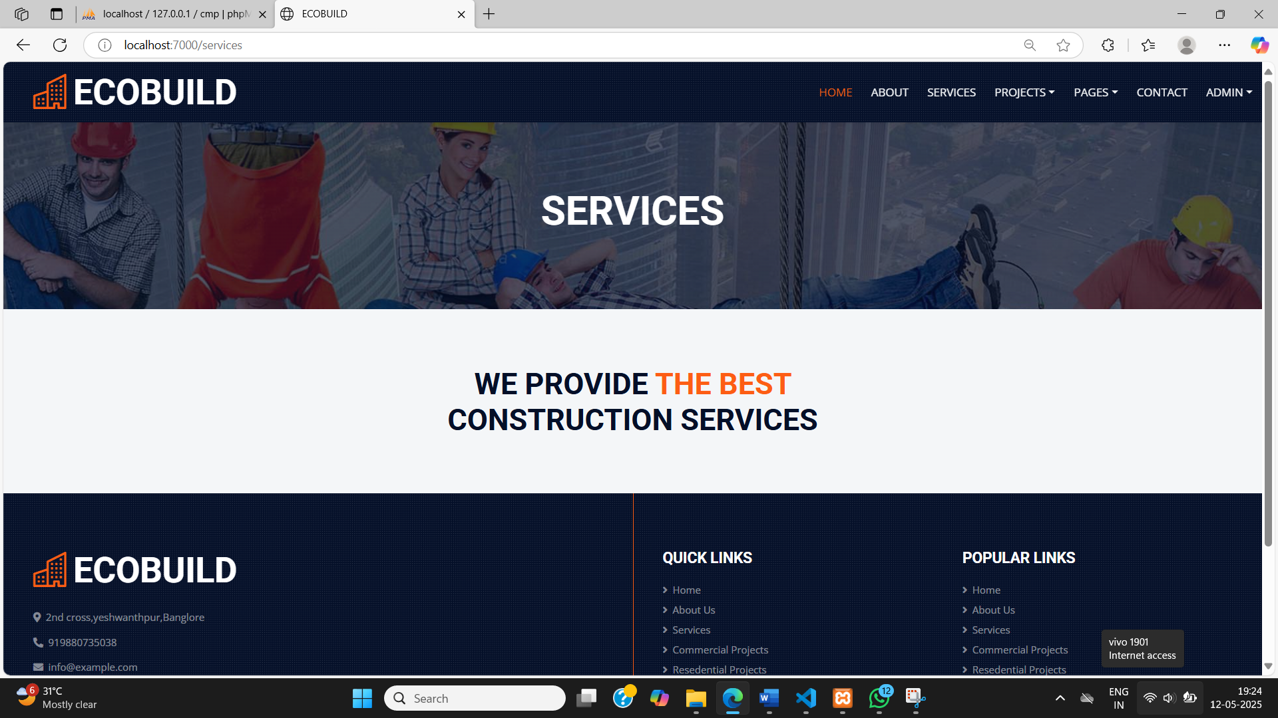
Fig 3:Services

Slide 12
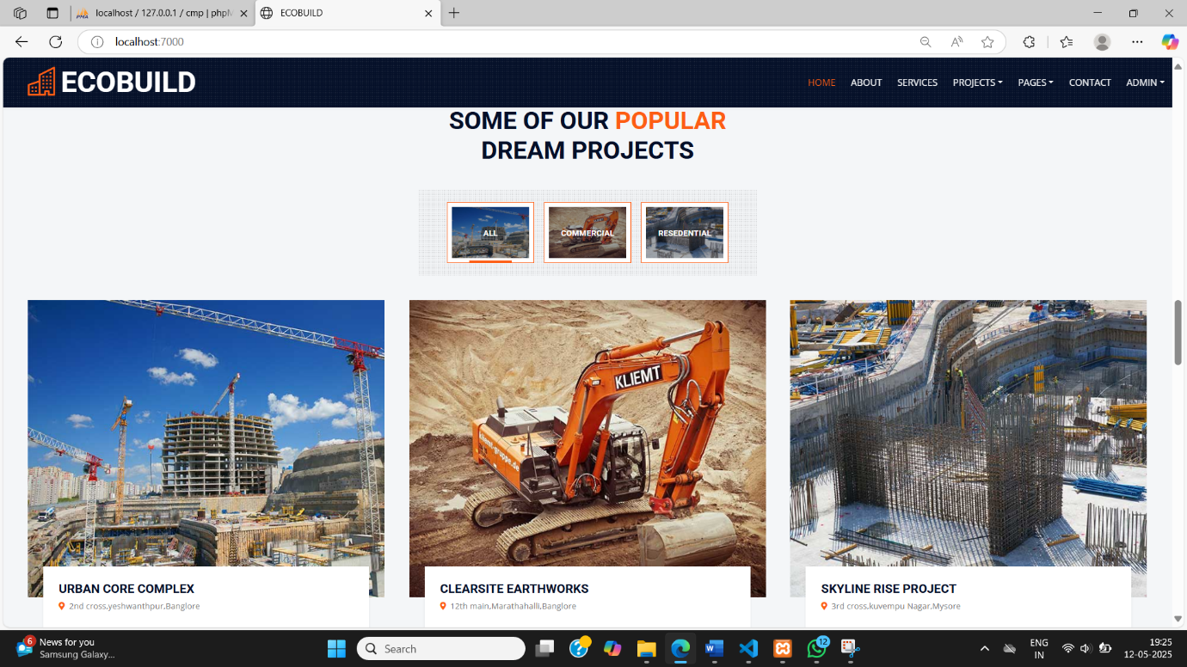
Fig 4:Projects

Slide 13
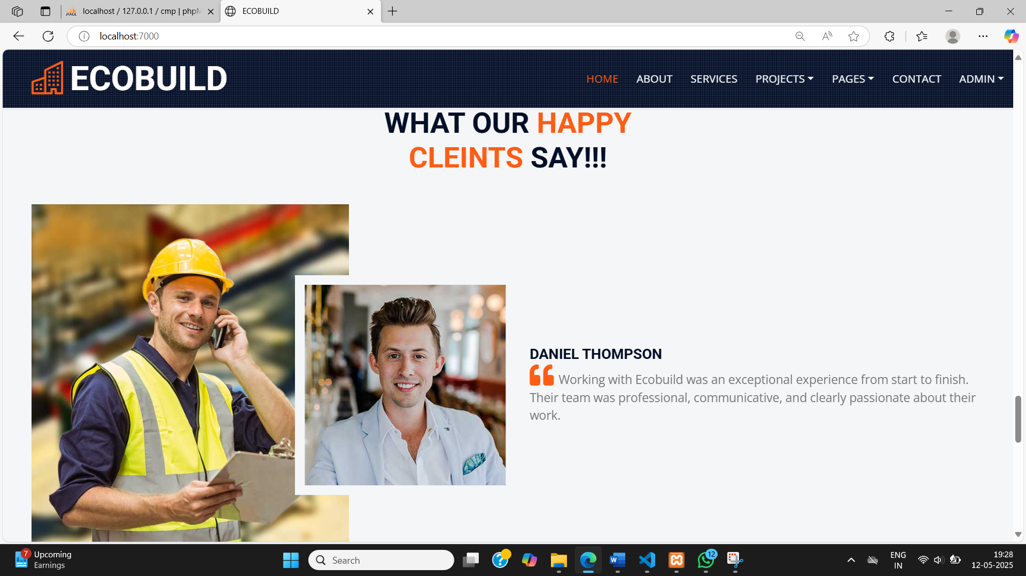
Fig 5:Testimonials

Slide 14
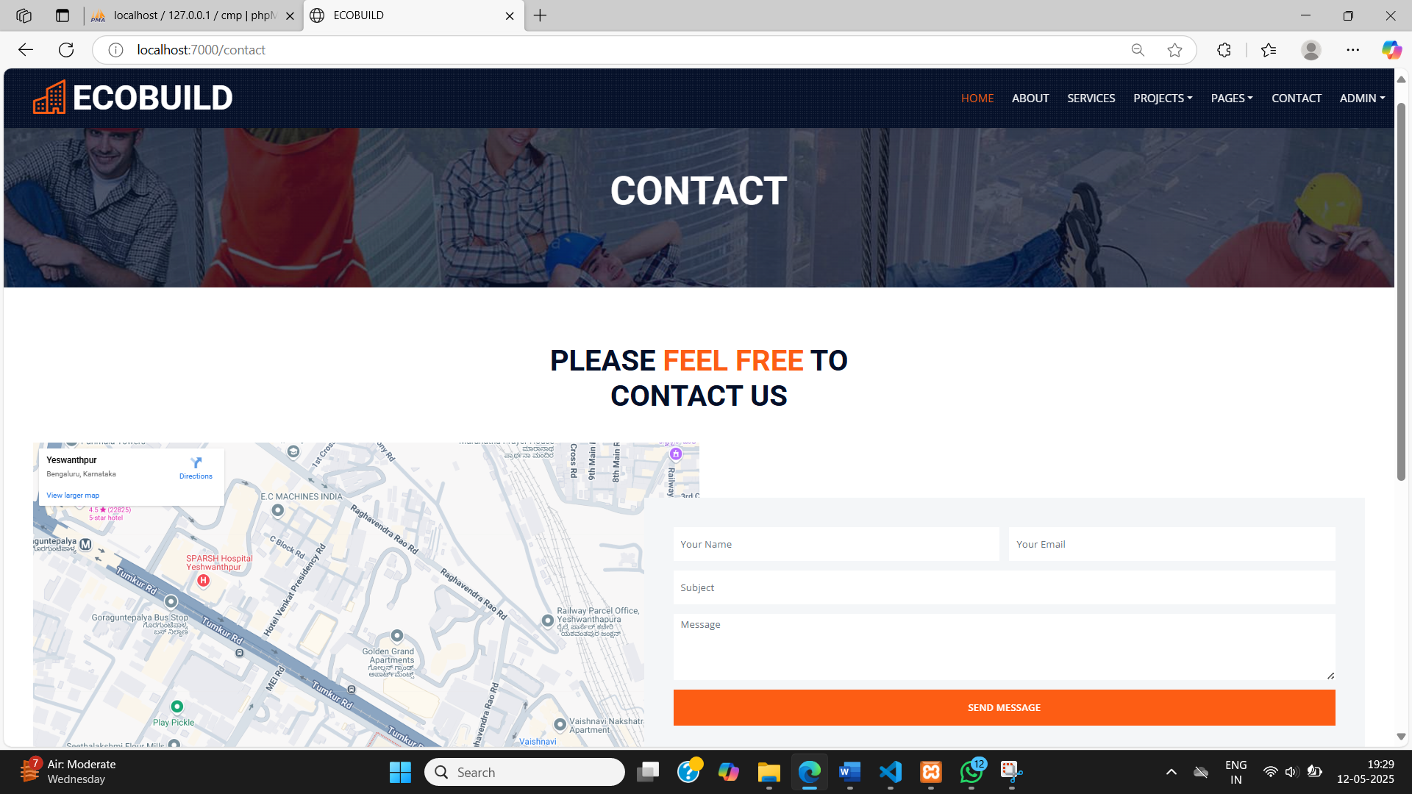
Fig 6:Contact Us

Slide 15
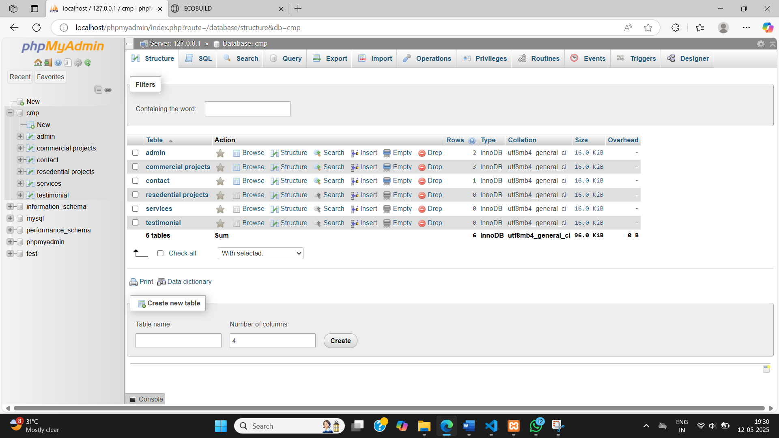
Fig 7:Database

Slide 16
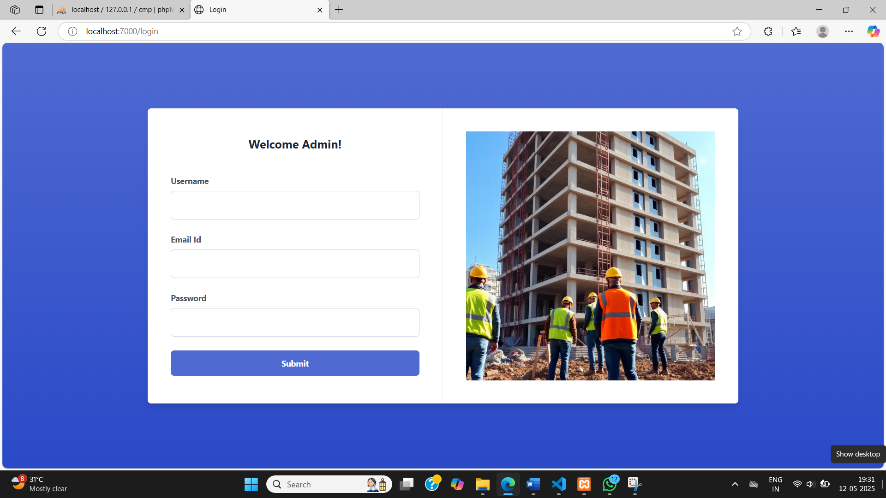
Fig 8:Admin Login

Slide 17
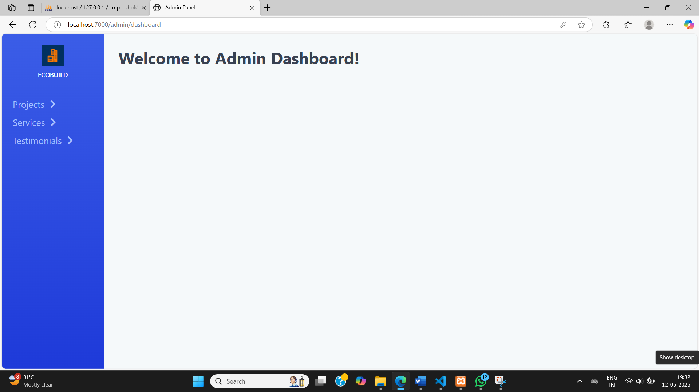
Fig 9:Admin Dashboard

Slide 18
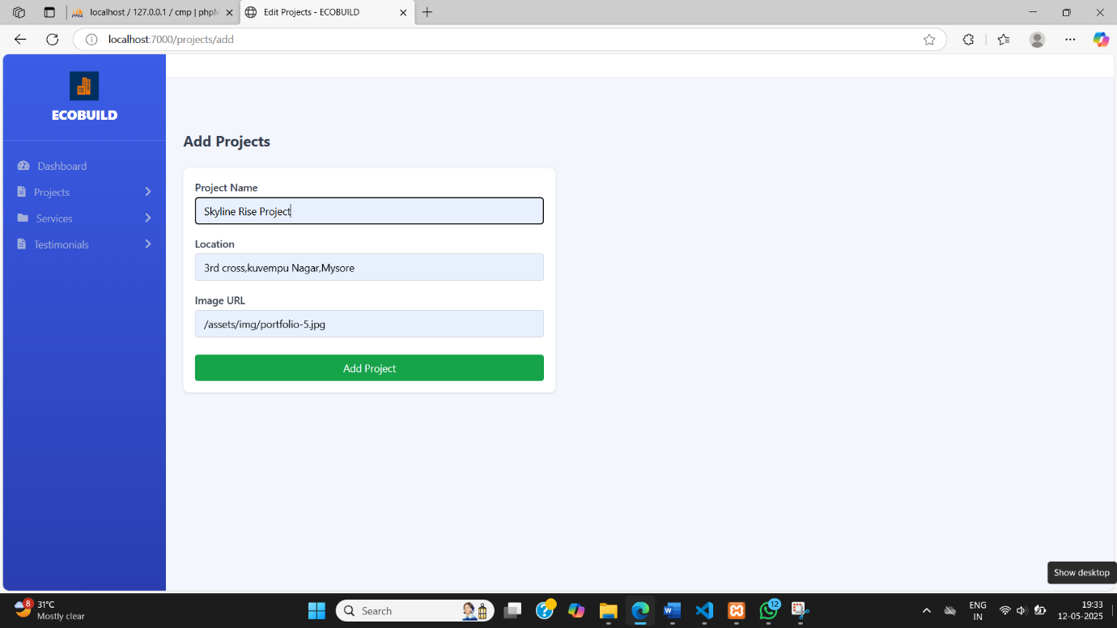
Fig 10:Add Projects

Slide 19
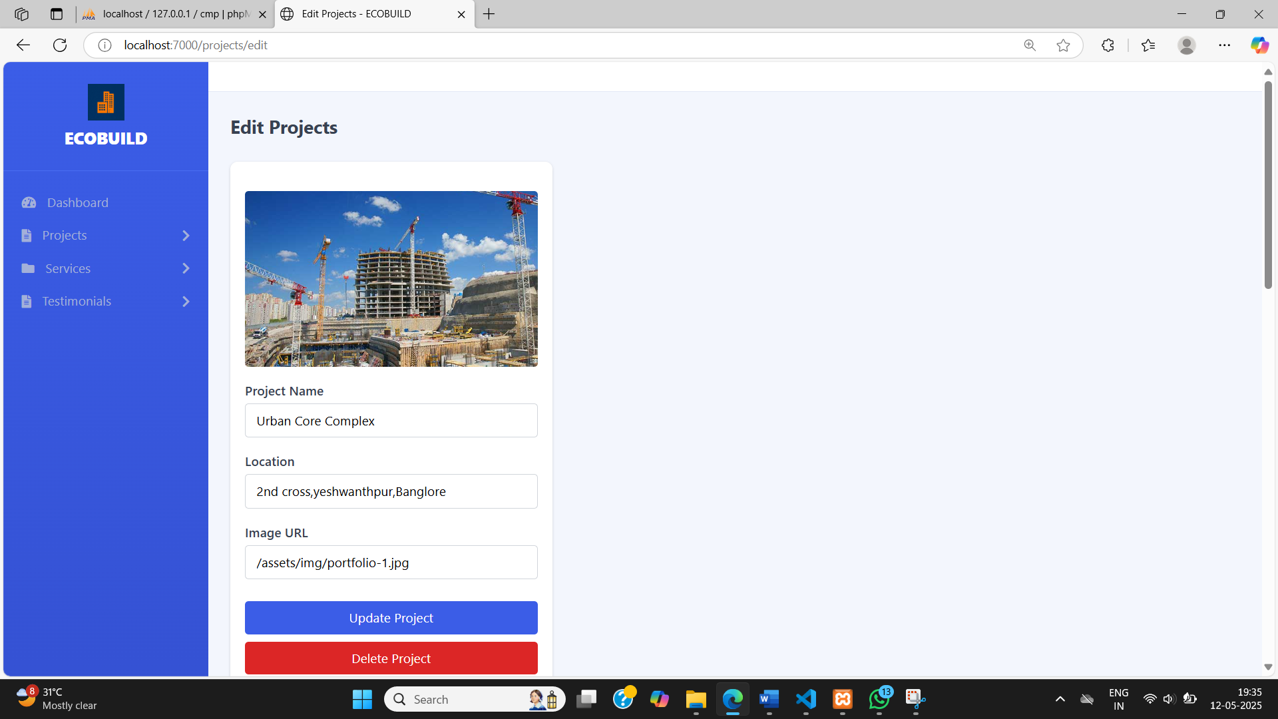
Fig 11:Edit Projects

Slide 20
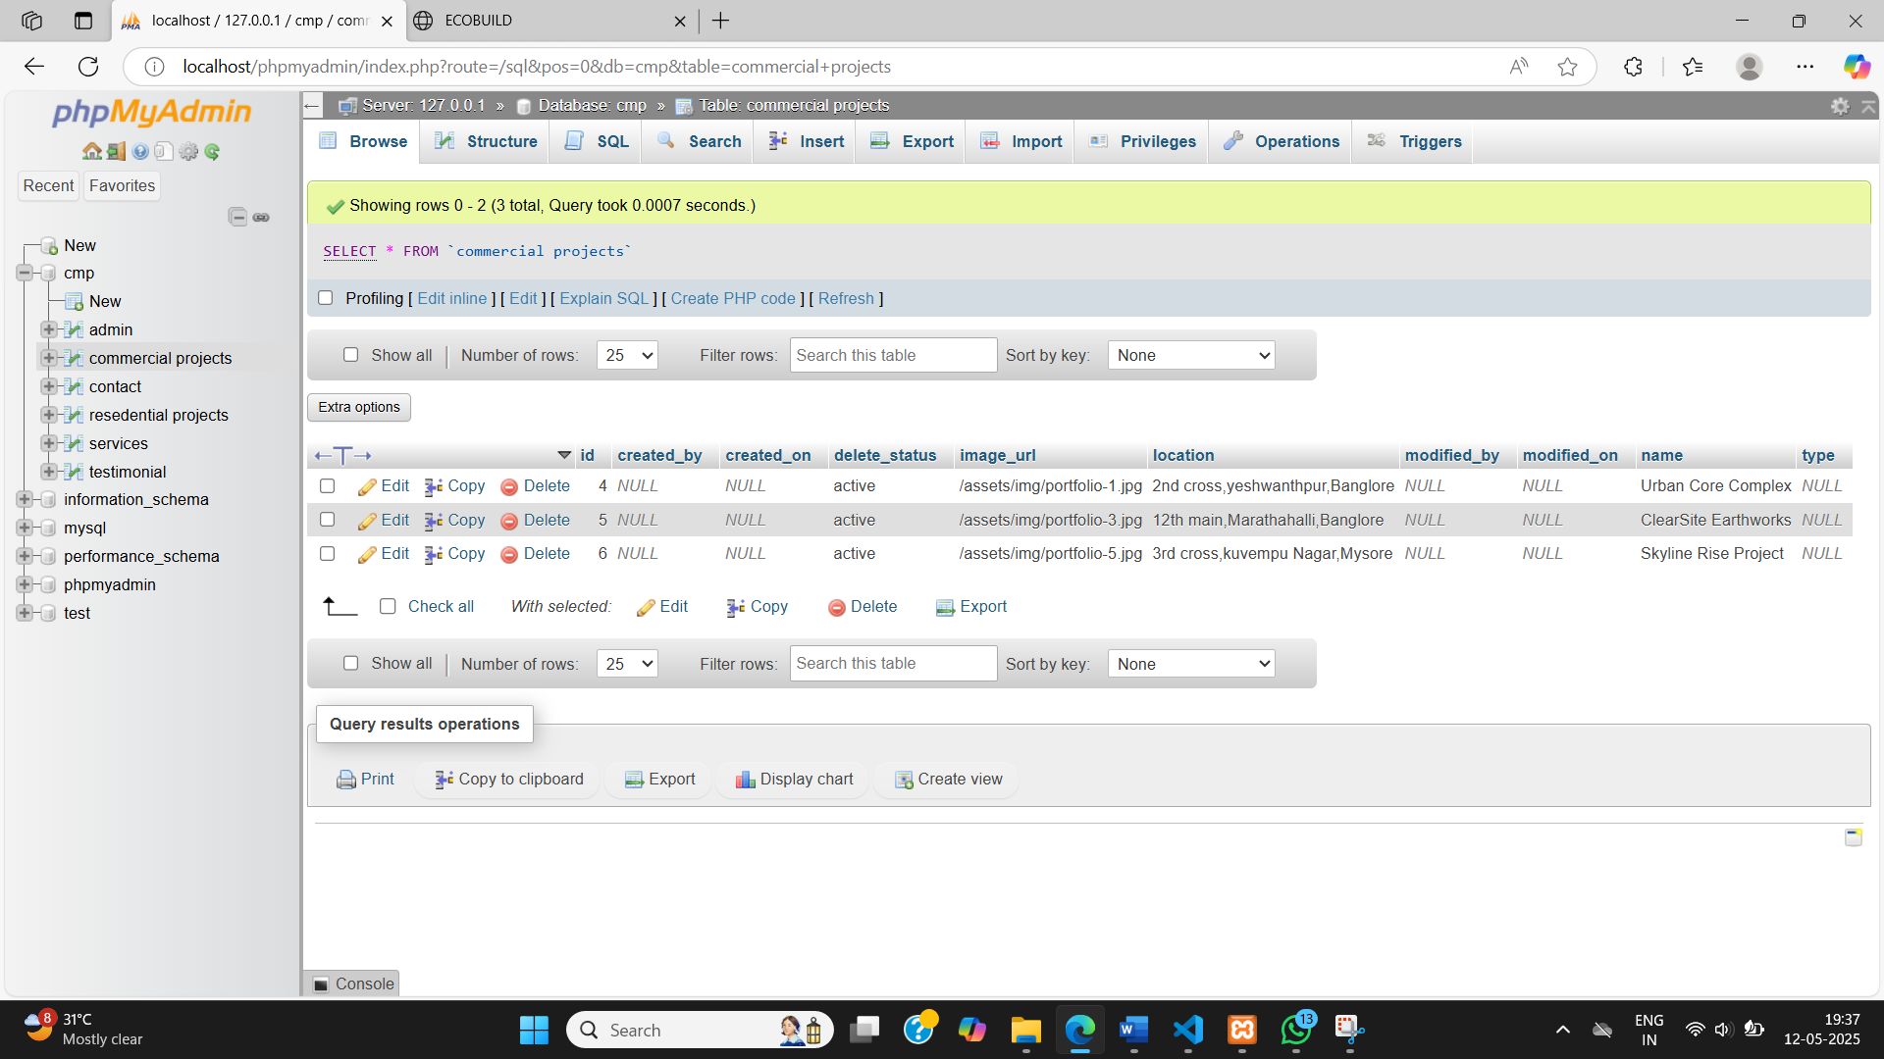
Fig 12:Data Stored in Mysql

Slide 21
FUTURE SCOPE
Spring Boot offers a promising future for dynamic construction projects by providing a scalable, flexible, and cloud-ready framework.
As construction management systems become more complex, Spring Boot’s support for microservices architecture allows for modular and adaptable solutions, ensuring seamless collaboration between different project components.
The integration of AI, IoT, and real-time analytics is expected to enhance project monitoring and resource optimization, reducing costs and delays.

Slide 22
CONCLUSION
Dynamic website serves as a digital tool for the construction company to showcase its expertise, engage with clients, and promote trust through real testimonials.
Admins can manage content easily, increasing productivity and reducing reliance on developers.
The website stays up-to-date with the latest information, which is crucial for a fast-moving industry like construction.

Slide 23
THANK YOU

